Slide 1
Despliegue continuo de tu infraestructura cloud con Azure ARM templates
Iván Chesa / Luis Mañez

Slide 2
Notes:
Carlos

Slide 3
Notes:
Carlos

Slide 4

Iván “la barba” Chesa
Dedicated to Azure and SharePoint development in the last years and certified by Microsoft as MCSE: Cloud Platform and Infrastructure.
https://www.linkedin.com/in/iv%C3%A1n-chesa-4284b7133/

Slide 5
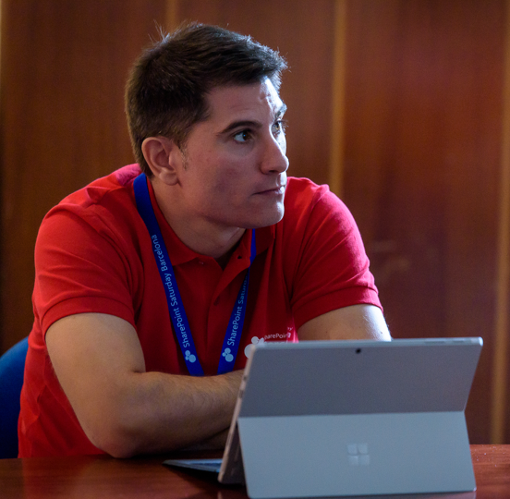
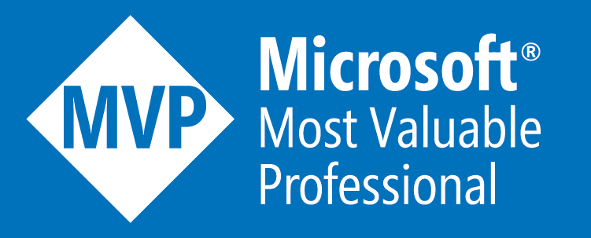
Luis Mañez
SharePoint and Cloud solutions architect en ClearPeople.
Office Development MVP. Cerca de 15 años trabajando con tecnologías Microsoft. SharePoint MCPD y Certified specialist in Developing Azure. OfficeDev PnP Key contributor.
https://twitter.com/luismanez
https://github.com/luismanez
https://medium.com/inherits-cloud
https://www.linkedin.com/in/luismanez/

Slide 6
Azure ARM Ventajas

Slide 7
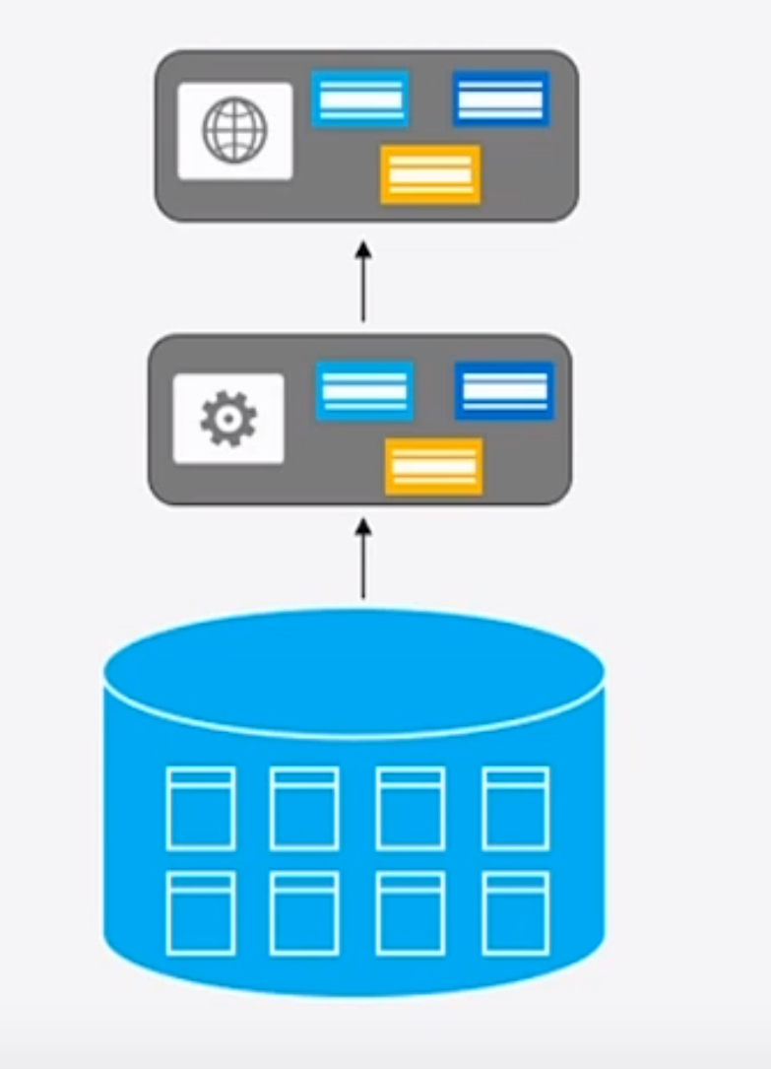
Monolithic Applications

Slide 8
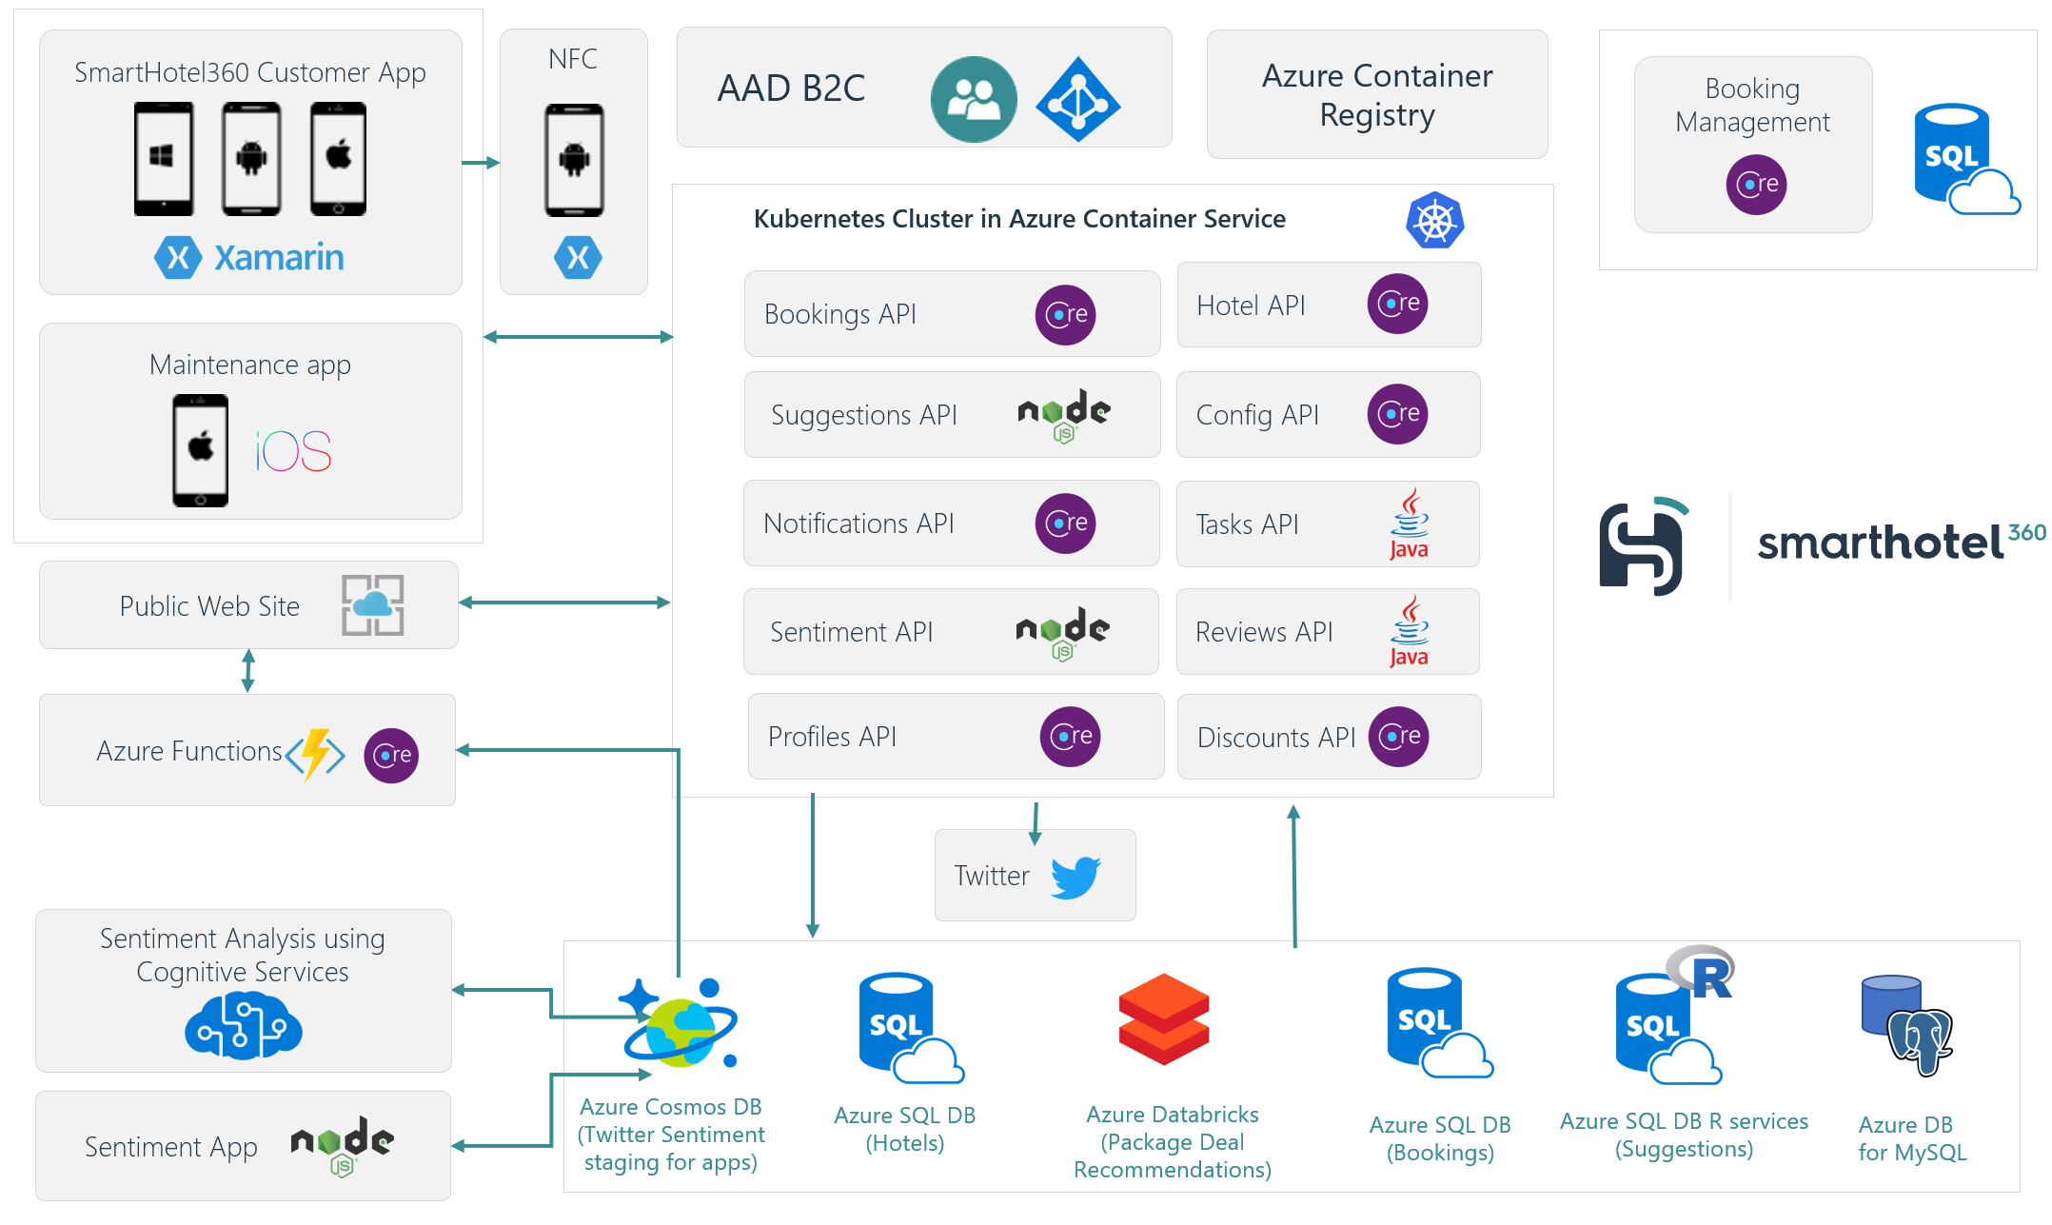
Microservices Applications

Slide 9
… and per environment
DEV
QA
PROD

